Slide 1
K-space sampling trajectories
Frank Zijlstra
St Olav’s University Hospital Trondheim, Norway Division of Medical Physics, University Medical Center Freiburg, Germany

Slide 2
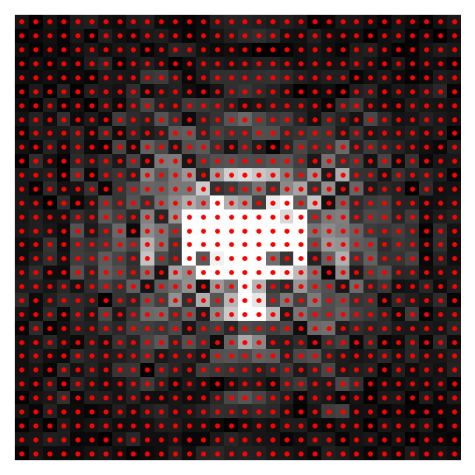
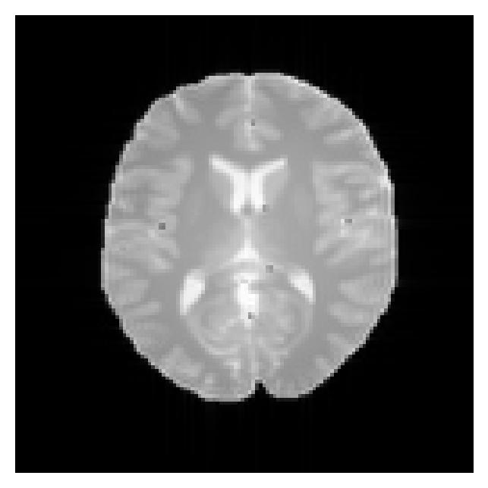
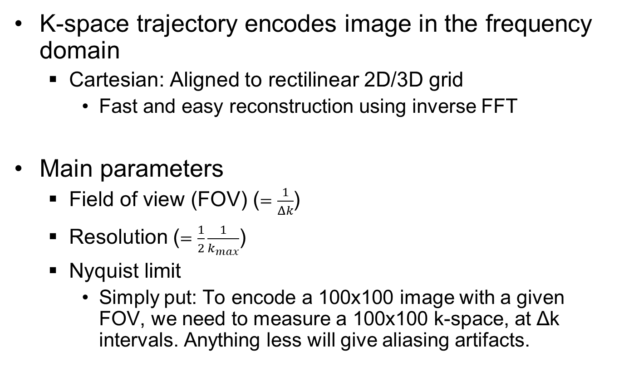
Example: 2D Cartesian trajectory
K-space
K-space trajectory encodes image in the frequency domain
Cartesian: Aligned to rectilinear 2D/3D grid
Fast and easy reconstruction using inverse FFT
Main parameters
Field of view (FOV) ($=\frac{1}{Δk}$)
Resolution ($=\frac{1}{2}\frac{1}{k_{max}}$)
Nyquist limit
Simply put: To encode a 100x100 image with a given FOV, we need to measure a 100x100 k-space, at Δk intervals. Anything less will give aliasing artifacts.
Inverse FFT

Slide 3
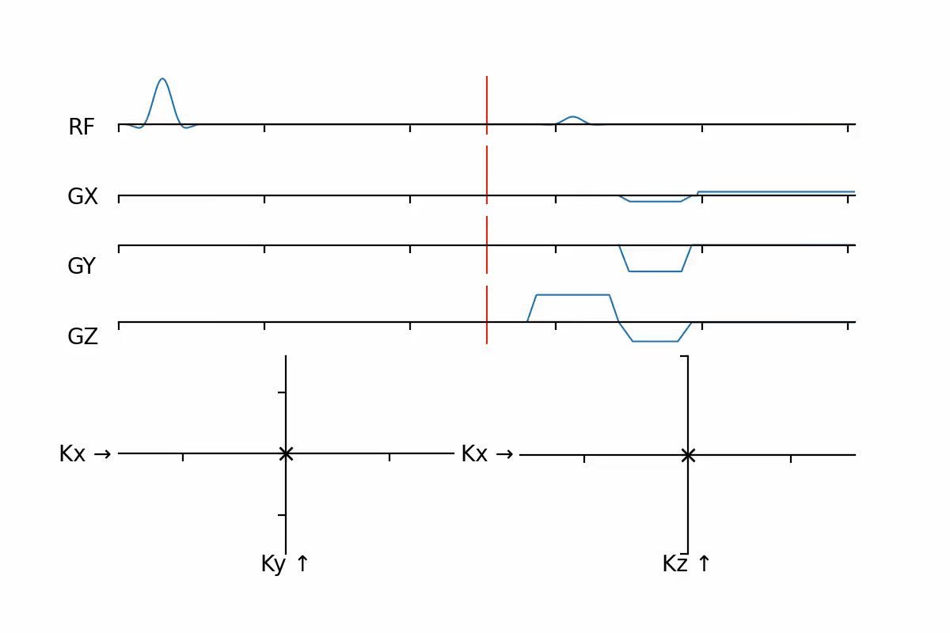
Example: 2D Cartesian trajectory
Other choices which affect the trajectory
Echo time / Repetition time
Readout bandwidth
Phase/frequency encoding direction
Oversampling in frequency encoding direction
Encode larger FOV by measuring more samples, same measurement time
Suppress aliasing artifacts, and artifacts from filters applied in receive coil hardware
Often removed in first step of reconstruction
1D IFFT → Crop → (1D FFT) on each line of raw data

Slide 4
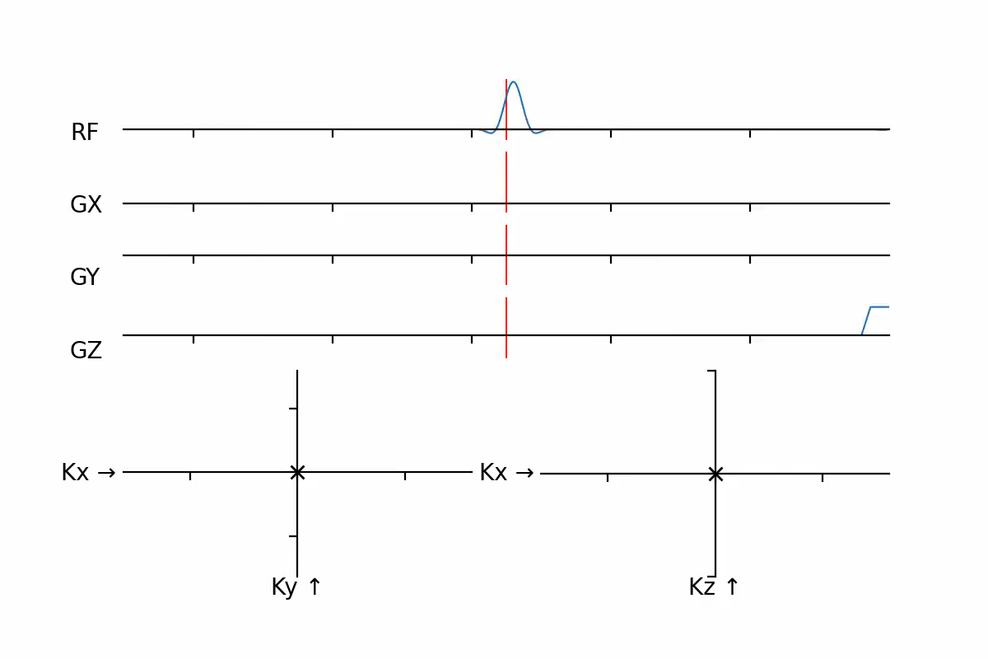
Example: 2D Cartesian trajectory
Full trajectory:

Slide 5
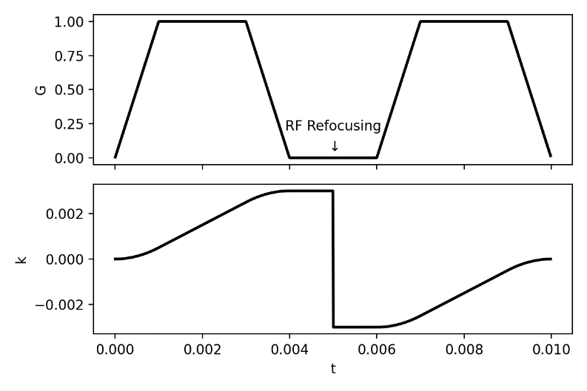
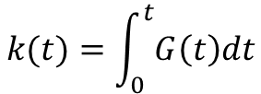
What defines the k-space trajectory?
An MRI pulse sequence traverses k-space using gradients and RF pulses
Area under gradients after excitation pulse
Reset to center of k-space at an RF excitation pulse
Mirrors in center of k-space at a RF refocusing pulse
Simplified view of reality
Effects of RF pulses are more complicated
Imperfections
e.g. eddy currents, gradient non-linearity (Next talk!)
$$k(t)=\int_{0}^{t}{G\left(t\right)dt}$$

Slide 6
Calculating the k-space trajectory in Pulseq
Pypulseq provides `seq.calculate_kspace` function
k_traj_adc, k_traj, t_excitation, t_refocusing, t_adc = seq.calculate_kspace()
Calculates both the full k-space trajectory (k_traj), and k-space trajectory during ADC events (k_traj_adc)
Also outputs RF excitation and refocusing times, and ADC times
Note: In MATLAB, use seq.calculate_kspacePP

Slide 7
Designing a k-space trajectory
Using Pulseq we can design almost any gradient waveforms
Therefore: We can design almost any k-space trajectory
Important: What part of k-space is measured when?
Limited by hardware
Maximum gradient strength
Maximum speed of k-space traversal
Maximum slew rate
Maximum change in k-space traversal speed/direction
Gradient duty cycle
Physiological limits
Peripheral nerve stimulation (PNS)
Sometimes: Specific absorption rate (SAR)

Slide 8
Why change the k-space trajectory?
Imaging speed
Faster k-space traversal can lower total scan time
Scan efficiency
Time spent receiving signal vs total scan time
Tradeoff SNR/resolution/scan time
Sensitivity to artifacts
Trajectory affects distortion due to B₀-inhomogeneity (e.g. around metal implants)
Appearance of motion/flow artifacts
Artifacts from signal inconsistencies
E.g. relaxation between multiple acquisitions
Contrast
Echo time typically defined by the time when k-space trajectory passes through center of k-space
Non-Cartesian trajectories can achieve very low echo times

Slide 9
MRI signal is not constant over time!
Many contributing factors
Relaxation effects
T2/T2* relaxation
T1 relaxation/saturation
Diffusion
Magnetization transfer
Off-resonance
Physiology
Flow, motion
Injection (and wash out) of contrast agent
Sequence
Imaging in transient-state vs steady-state
Use of preparation gradients/RF pulses
Cardiac/respiratory triggering
Etc.
Some factors affect mainly short term (e.g. frequency encoding), others affect longer term (e.g. phase encoding)
Assuming constant signal is a common mistake in retrospective image reconstruction experiments
i.e. measured signal = FFT(image)

Slide 10
Overview
Variations on Cartesian trajectories
Multiple echoes
K-space ordering
K-space undersampling
Non-Cartesian trajectories
Radial
Spiral

Slide 11
Multiple echoes
We are not limited to having one readout per TR!
You can have as many ADC events as you want (within reason..)
They do not even need to have the same number of samples!
We are not limited to measuring a k-space location only once
Add measurements together
Averaging for better SNR, or to mitigate artifacts (e.g. motion)
Acquire multiple contrasts in one sequence

Slide 12
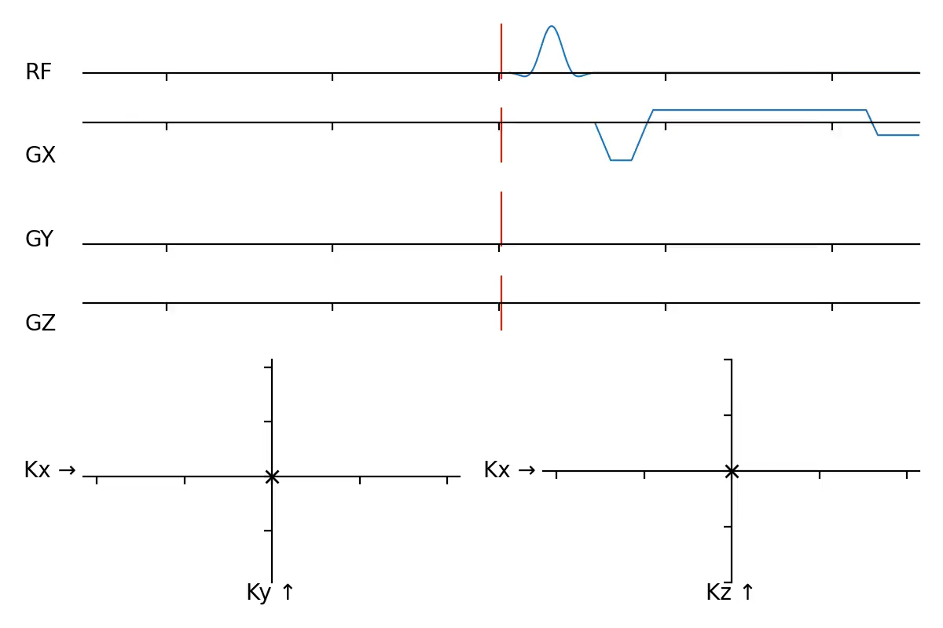
Multiple echoes
Bi-polar readouts: Going back and forth
Acquires same k-space line twice (or more)
Multiple echo times
Opposite readout directions
Opposite direction for ΔB₀-induced distortion
Applications:
T2* mapping
Quantitative susceptibility mapping
Dixon water-fat separation
Implementation:
seq.add_block(gx_pre, gy_pre)
seq.add_block(gx, adc)
seq.add_block(pp.scale_grad(gx, -1), adc)

Slide 13
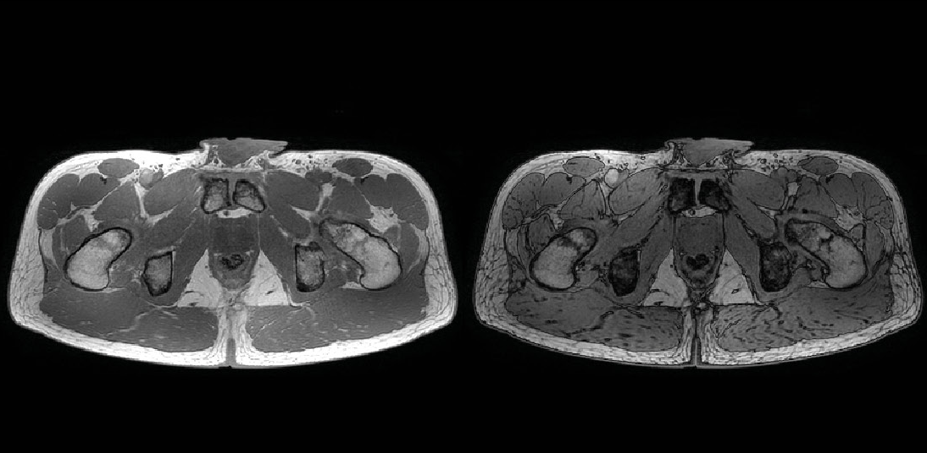
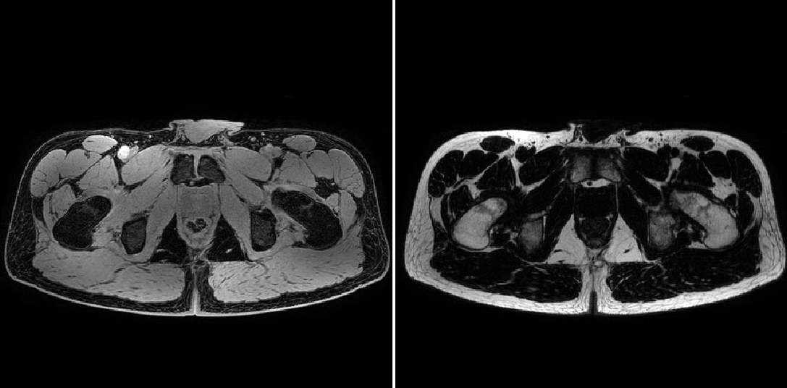
Multiple echoes: Water-fat separation
Acquired images (2 echoes, complex-valued)
Water
Fat

Slide 14
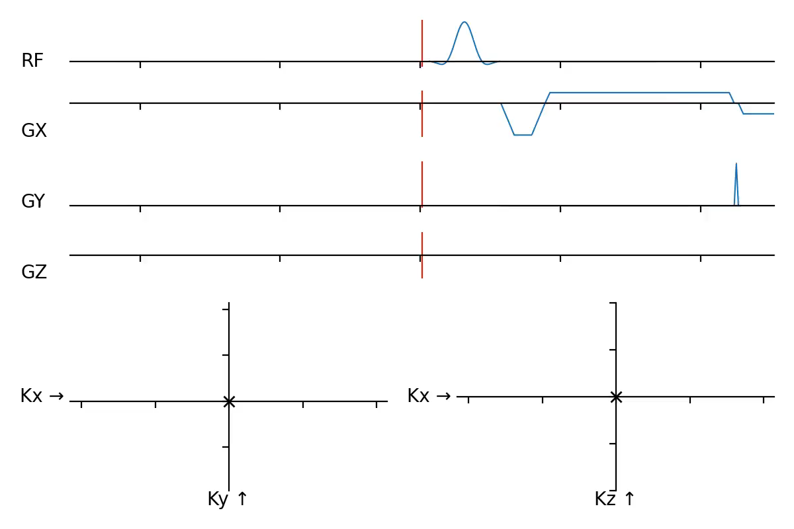
Multiple echoes: EPI
Alternatively, we can add phase encoding to encode multiple k-space lines
Echo planar imaging (EPI)
Bi-polar readout, with small phase encoding gradient (“blip”) in between
More on Day 2!
Applications:
Fast imaging
Diffusion-weighted imaging
Implementation:
seq.add_block(gx_pre, gy_pre)
seq.add_block(gx, adc)
seq.add_block(gy_blip)
seq.add_block(pp.scale_grad(gx, -1), adc)

Slide 15
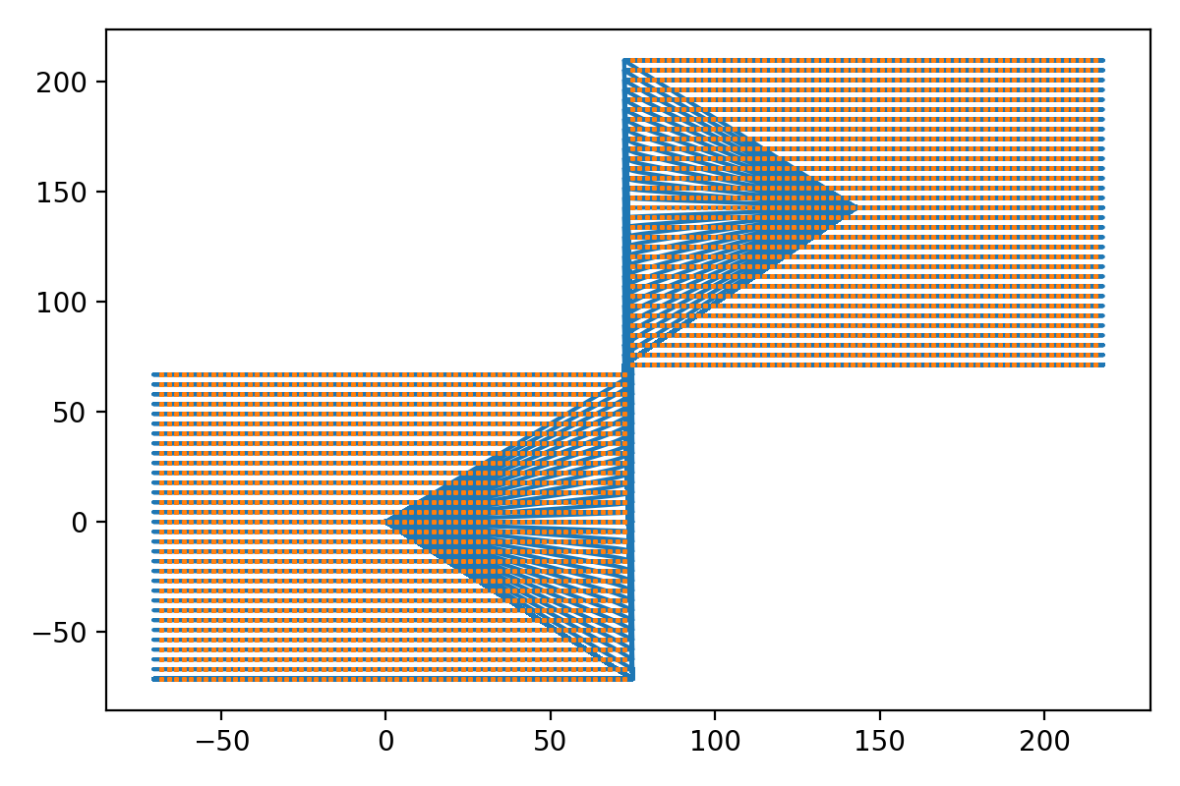
Multiple echoes
Coming up on day 2:
Turbo Spin Echo (TSE)
Measures multiple spin echoes in one TR
Double-echo steady-state (DESS)
Measures multiple contrasts originating from FID and stimulated echo signals
K-space calculation “fails”
RF pulse acts as both excitation and refocusing!
Example DESS k-space trajectory

Slide 16
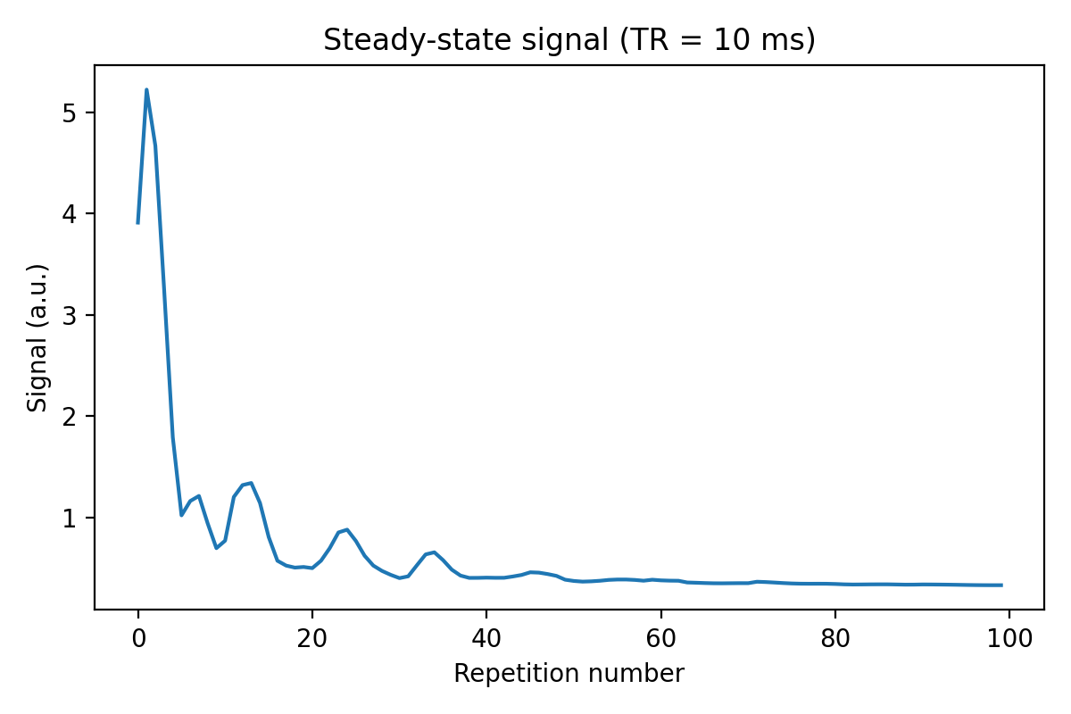
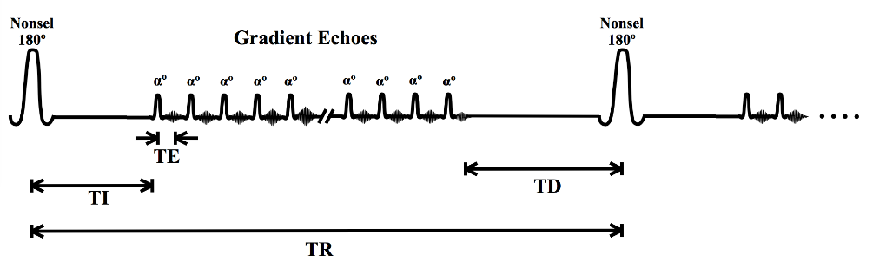
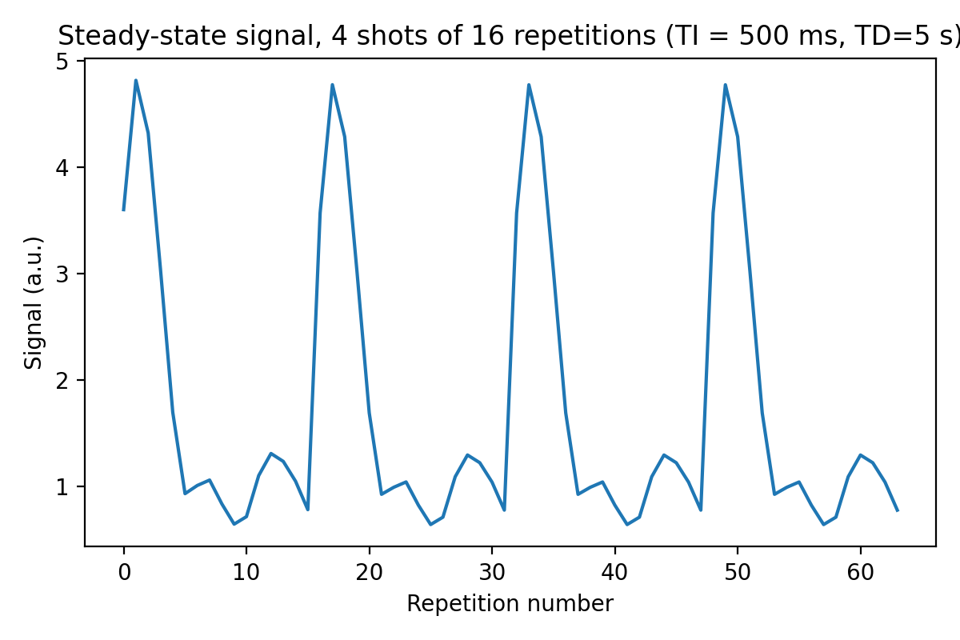
K-space ordering
Ordering matters!
Signal changes can occur over repetitions
E.g. patient motion, flow
Contrast injection
Triggered scans
In many sequences, the MR signal changes by design
Imaging in transient-state (e.g. start of gradient echo acquisitions)
Sequences with pre-pulses
Example: IR-GRE (Siemens: MPRAGE)

Slide 17
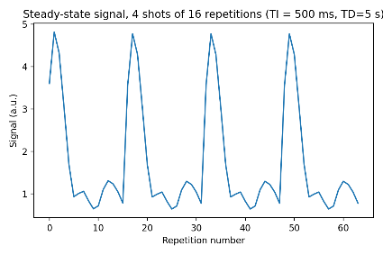
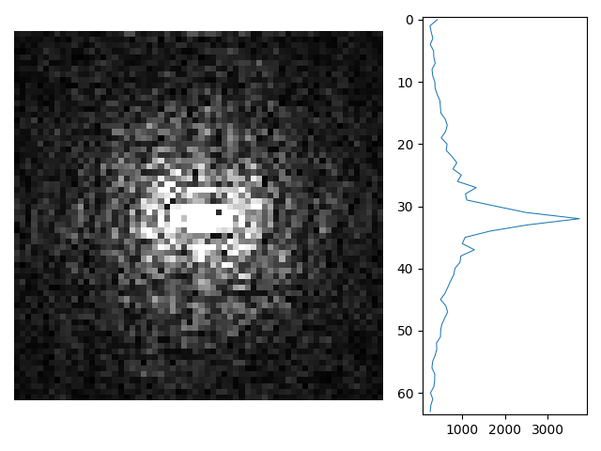
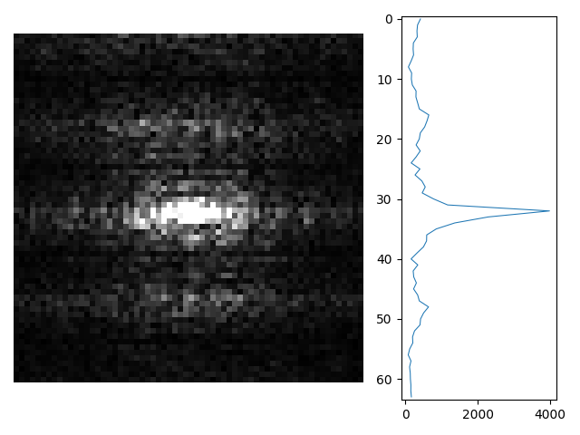
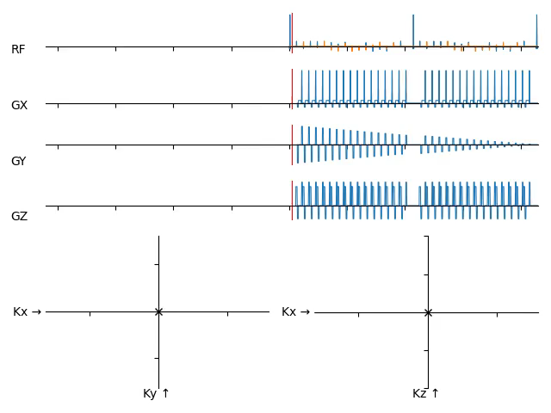
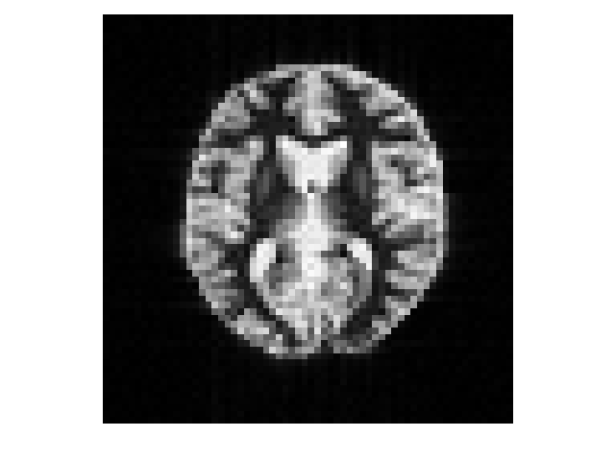
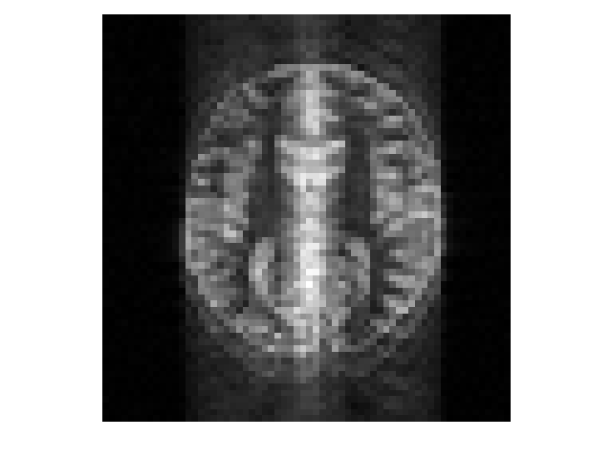
K-space ordering: IR-GRE, linear order
Expectation
Reality

Slide 18
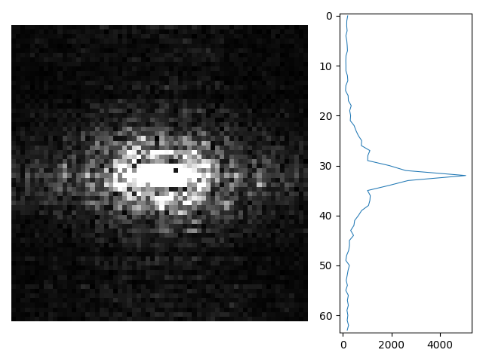
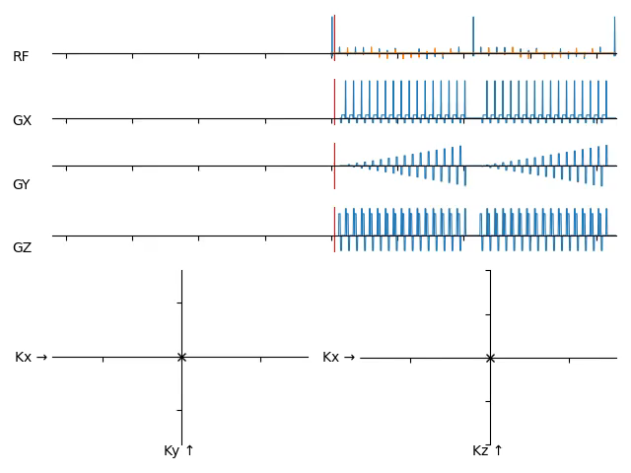
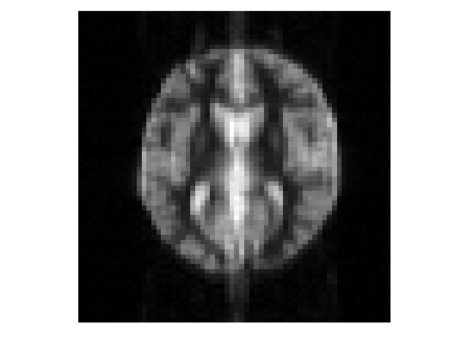
K-space ordering: IR-GRE, centric order
Expectation
Reality

Slide 19
K-space ordering
Common types of ordering in Cartesian acquisition
Linear (high to low, or low to high)
In 3D: YZ vs ZY
Center-out (or reversed)
Random
Implementation: DIY in exercise session!

Slide 20
Undersampling
Break the Nyquist limit to scan faster
Acquire fewer phase encoding lines
Common undersampling methods
Partial Fourier
Parallel imaging
Compressed sensing
Special reconstruction needed to fill in missing data
Note: It may not always be apparent, but SNR almost always decreases with undersampling!
Implementation
Special case of k-space ordering: also decide which k-space lines we acquire

Slide 21
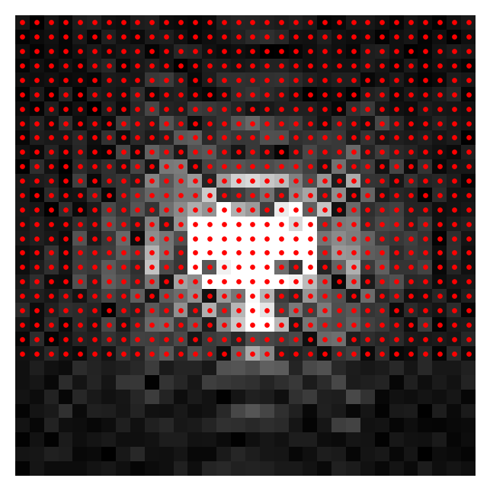
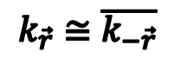
Partial Fourier
$$k_{\vec{r}}≅\overline{k_{−\vec{r}}}$$
If phase information in an image is smooth, the k-space is approximately Hermitian symmetric
Accelerate by acquiring asymmetric k-space
Homodyne reconstruction
McGibney G, Smith MR, Nichols ST, Crawley A. Quantitative evaluation of several partial Fourier reconstruction algorithms used in MRI. Magn Reson Med 1993;30:51-59

Slide 22
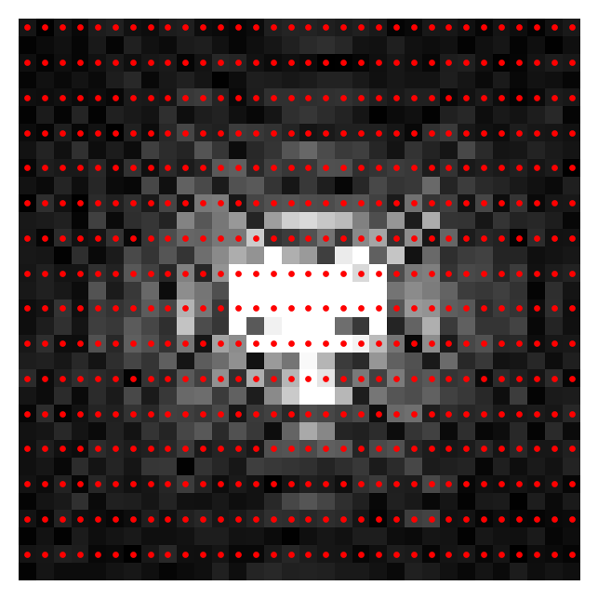
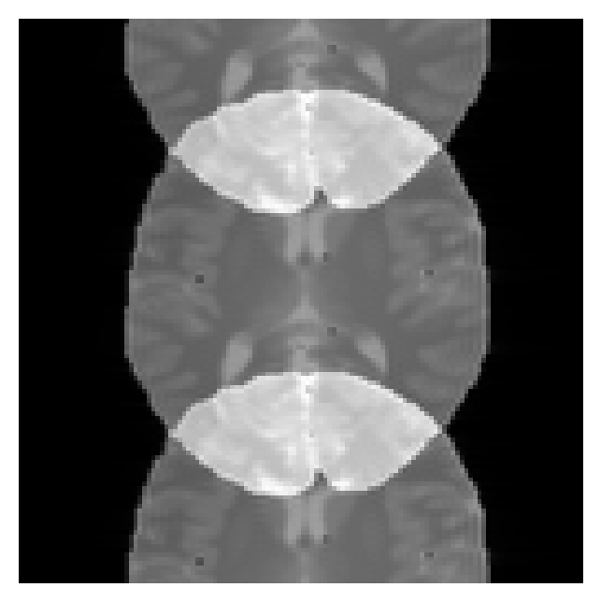
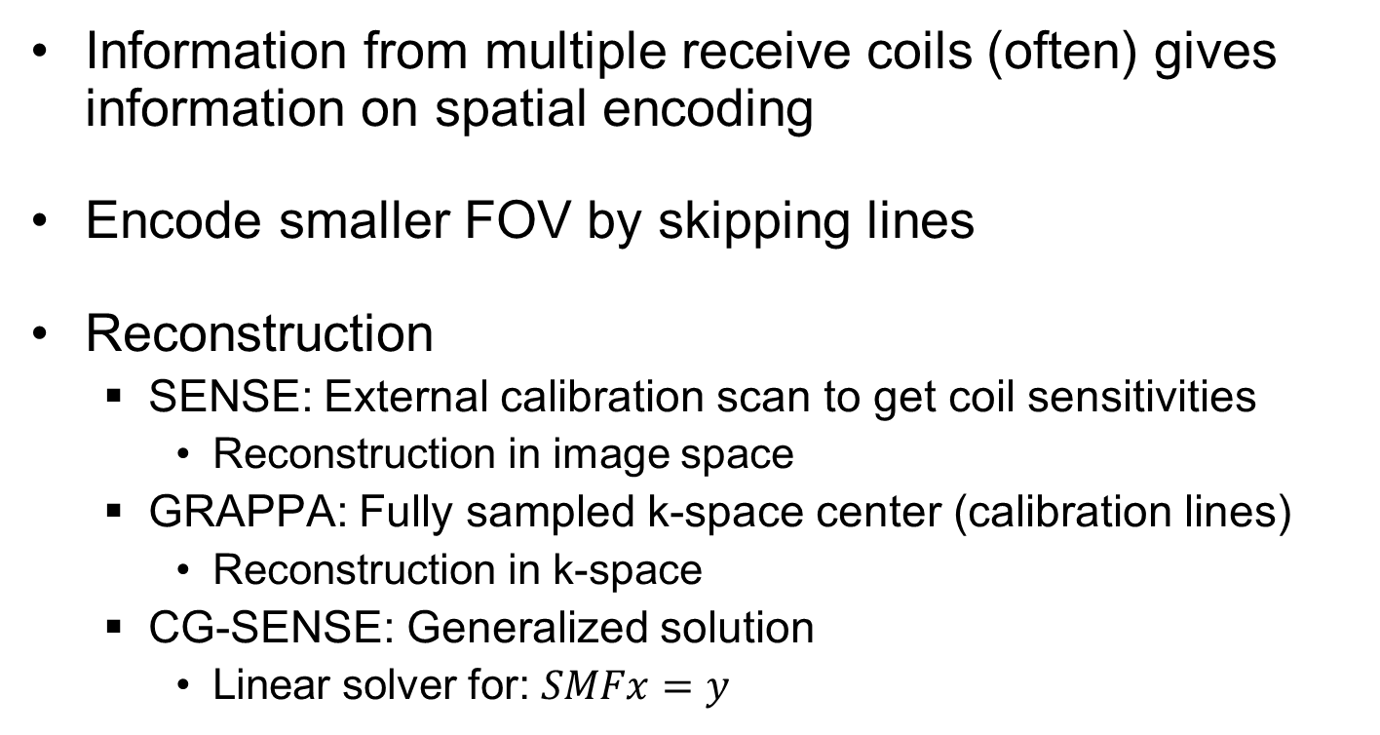
Parallel imaging
Information from multiple receive coils (often) gives information on spatial encoding
Encode smaller FOV by skipping lines
Reconstruction
SENSE: External calibration scan to get coil sensitivities
Reconstruction in image space
GRAPPA: Fully sampled k-space center (calibration lines)
Reconstruction in k-space
CG-SENSE: Generalized solution
Linear solver for: $SMFx=y$
Pruessmann KP, Weiger M, Scheidegger MB, Boesiger P. SENSE: Sensitivity encoding for fast MRI. Magn Reson Med 1999; 42:952-962.
Griswold MA, Jakob PM, Heidemann RM, et al. Generalized autocalibrating partially parallel acquisitions (GRAPPA). Magn Reson Med 2002; 47:1202-1210

Slide 23
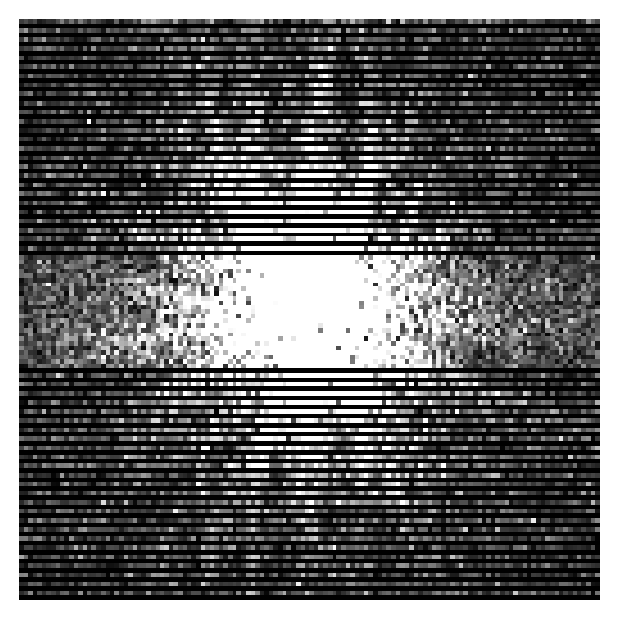
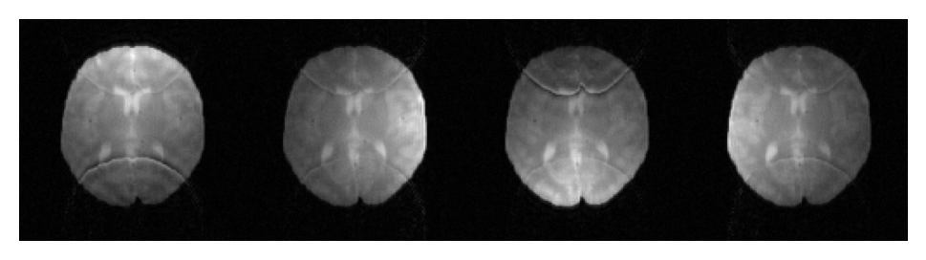
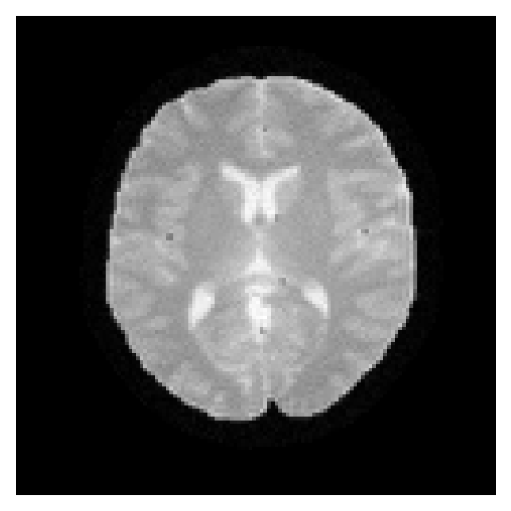
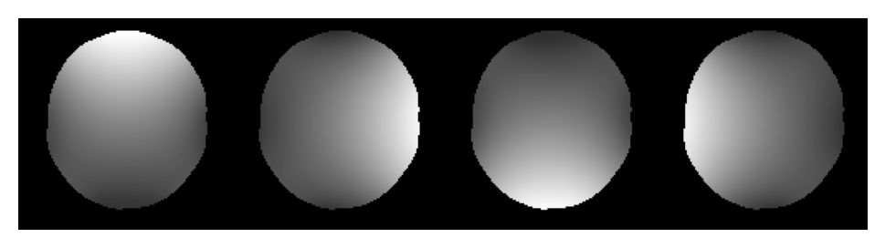
Parallel imaging
K-space (first coil)
Coil images
Reconstruction
Coil sensitivities

Slide 24
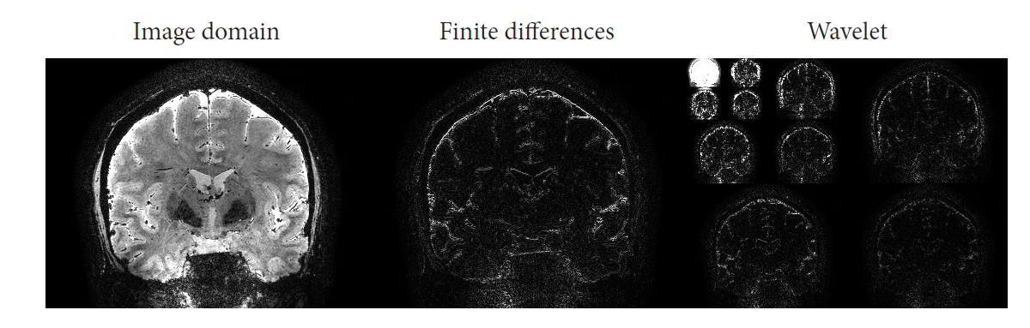
Compressed sensing
Medical images are often compressible
Information content is less than number of voxels
Sparsity
Many zeroes/low signals in image
Smooth or piecewise constant signal
Many zeroes after a given transform (e.g. wavelet transform)
Sub-Nyquist sampled images can be reconstructed by assuming the reconstructed image is sparse in some fashion

Slide 25
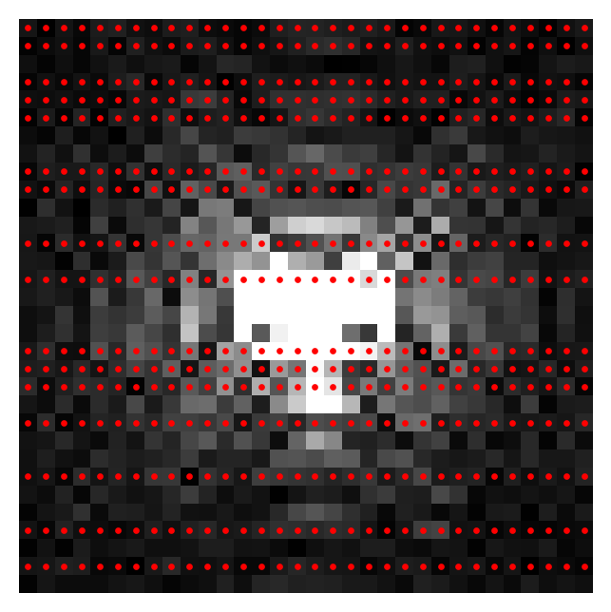
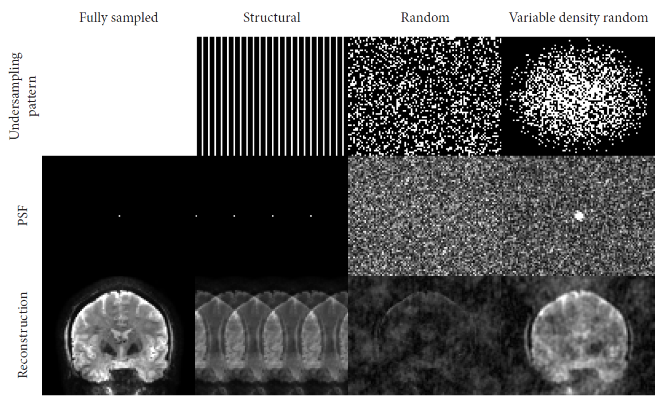
Compressed sensing
Instead of dropping k-space lines at regular intervals, sample (pseudo-)randomly
Random aliasing pattern

Slide 26
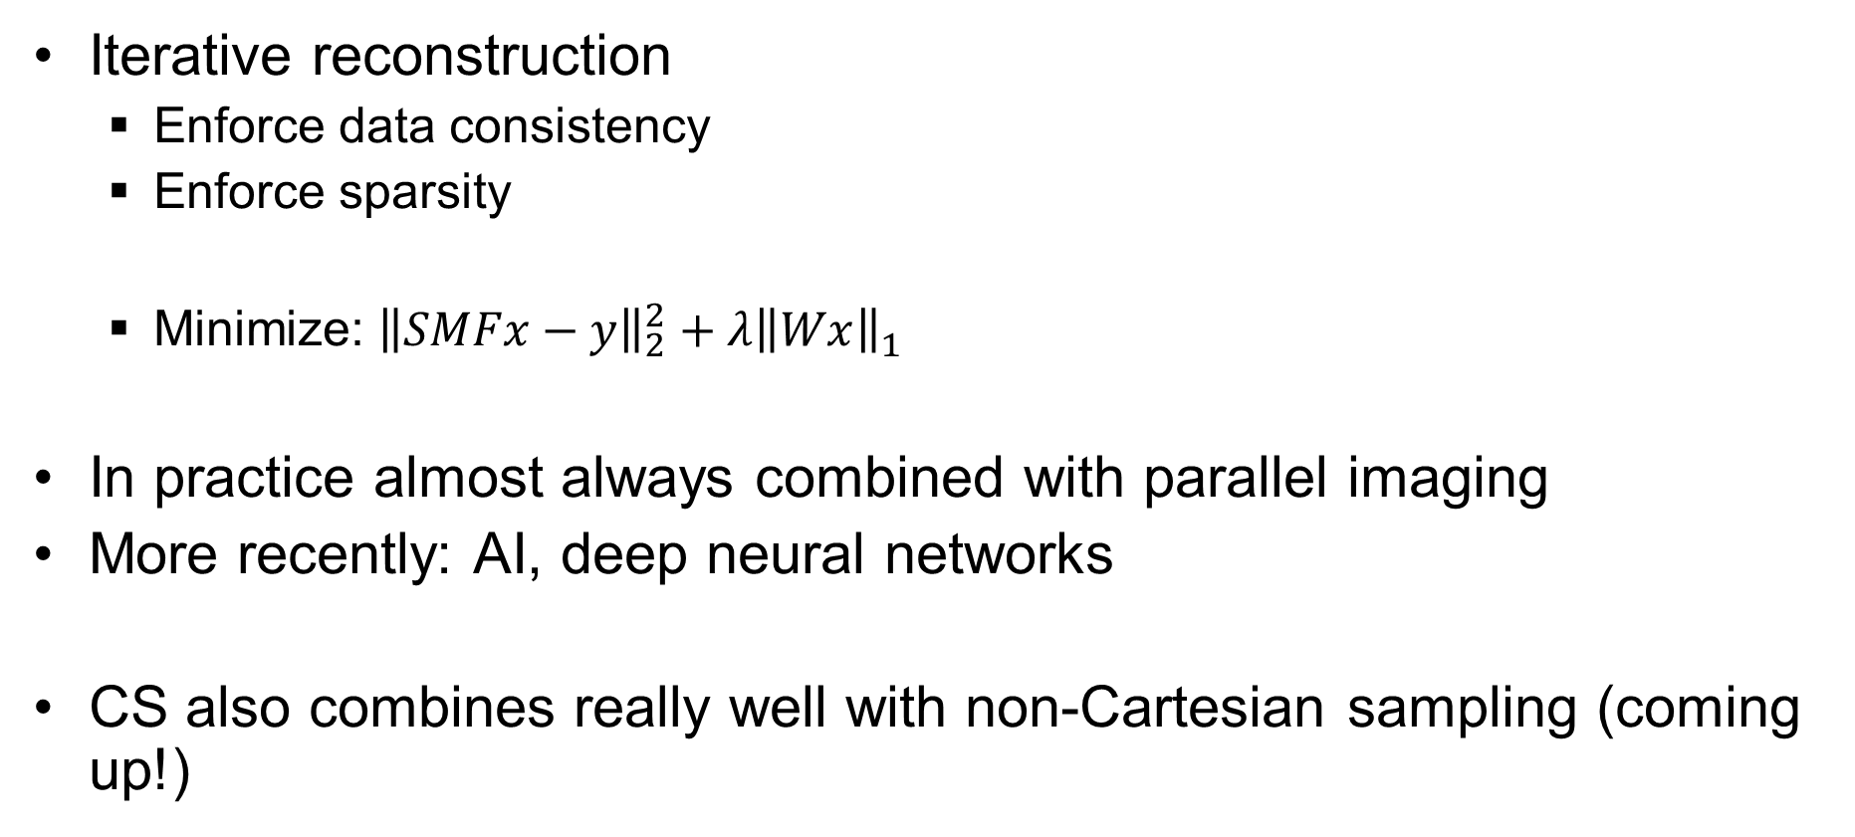
Compressed sensing: Reconstruction
Iterative reconstruction
Enforce data consistency
Enforce sparsity
Minimize: ${\left\|SMFx−y\right\|}_{2}^{2}+λ{\left\|Wx\right\|}_{1}^{}$
In practice almost always combined with parallel imaging
More recently: AI, deep neural networks
CS also combines really well with non-Cartesian sampling (coming up!)

Slide 27
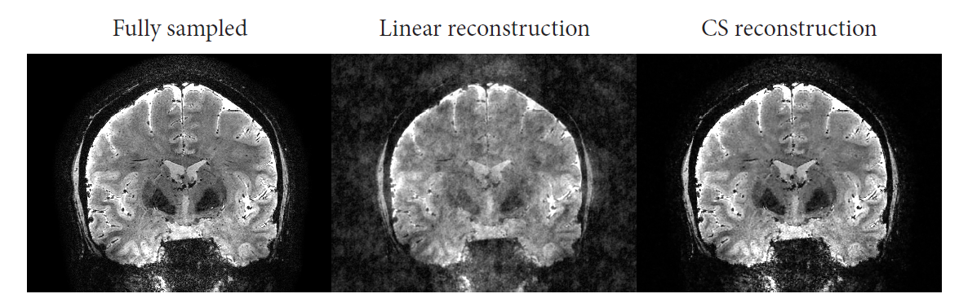
Compressed sensing: Reconstruction

Slide 28
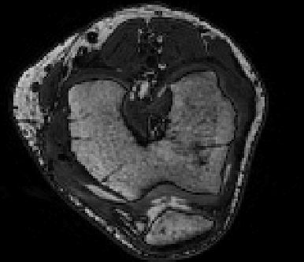
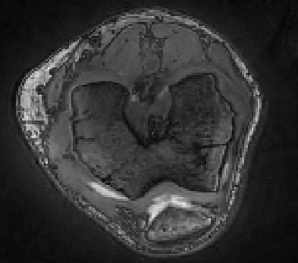
Compressed sensing: Reconstruction
Fully sampled
CS reconstruction
Undersampling pattern started in the center of k-space
Still in transient state…
K-space order matters!

Slide 29
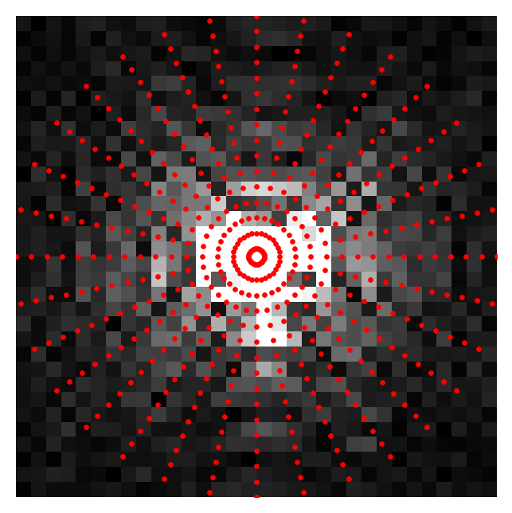
Non-Cartesian sampling
Sampling on a Cartesian grid makes reconstruction easy
But we are not restricted to this grid
Why?
Artifacts for motion and other inconsistencies can be mitigated
Scan efficiency
Dynamic imaging
E.g. free-breathing abdominal/cardiac imaging (collect data first, then separate motion phases and reconstruct)
Ultimate freedom in k-space trajectory
Challenges
Implementation
Reconstruction
Artifacts (e.g. B₀-inhomogeneity)
Typically not available in clinical applications

Slide 30
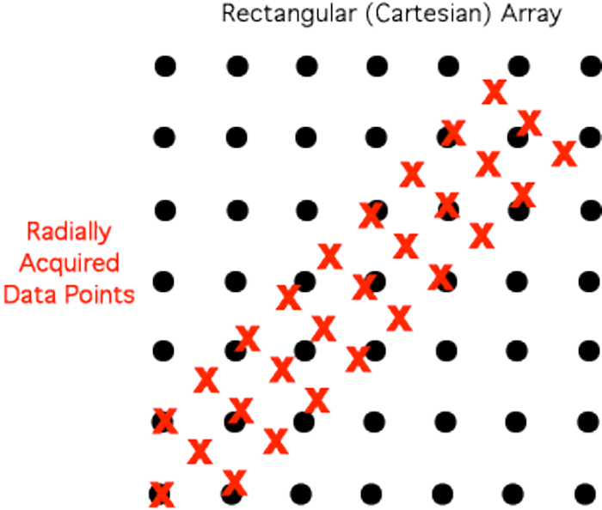
Non-Cartesian reconstruction
Adjoint Non-uniform Fast Fourier Transform (NUFFT)
Gridding: Interpolate data at known non-Cartesian locations to Cartesian grid
Then perform 2D/3D IFFT
Many implementations available!
Note: Adjoint NUFFT is not an inverse NUFFT
Approximate inverse NUFFT
Perform sampling density compensation
Areas with many samples need to be weighted less
Then adjoint NUFFT
Alternatively: Iterative linear least squares reconstruction
K-space coordinates easily calculated with Pulseq!
seq.calculate_kspace()

Slide 31
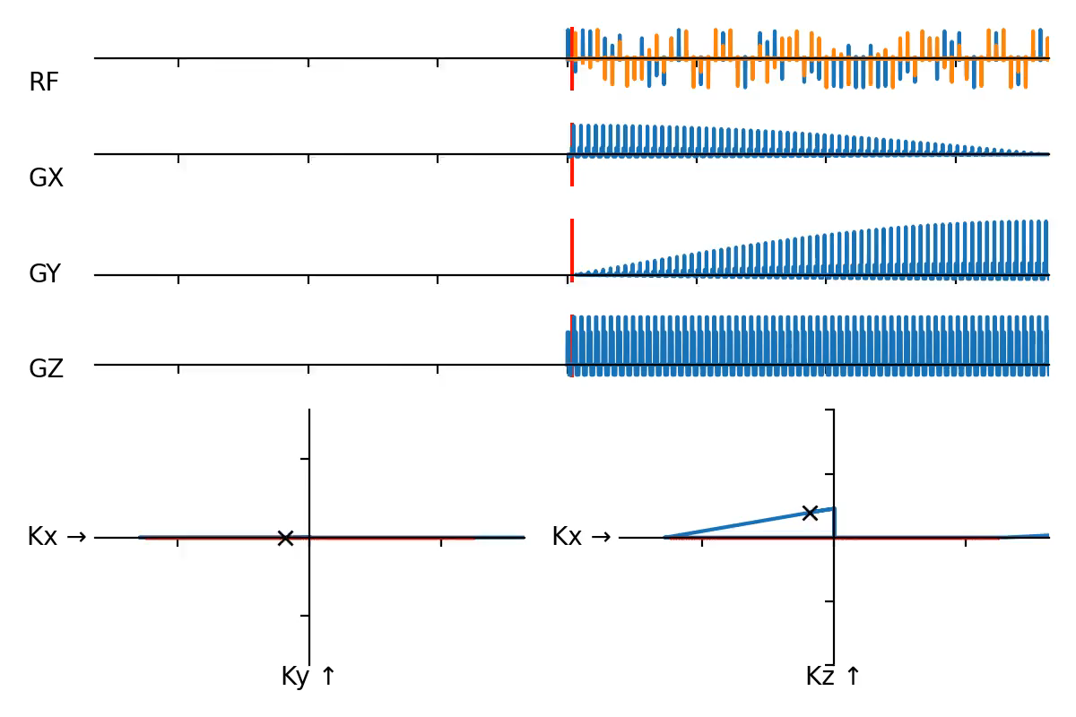
Radial
“Star” pattern
Every acquisition is a line through center of k-space (“spoke”)
Projection of all signal perpendicular to direction
No phase encoding
Sampling density: Very dense sampling in k-space center
Implementation:
seq.add_block(gx_pre, gy_pre)
seq.add_block(*pp.rotate(gx, angle=phi, axis=‘z’), adc)

Slide 32
Radial
Advantages
Averaging in k-space center
Signal inconsistencies average out
More benign motion artifacts (blurring)
Frequency encoding in all directions
Easy to reduce artifacts from signal outside FOV with readout oversampling
Benign undersampling artifacts
Disadvantages
Nyquist sampling requires more repetitions because low sampling density on k-space boundary
Streaking artifacts can spread through entire image

Slide 33
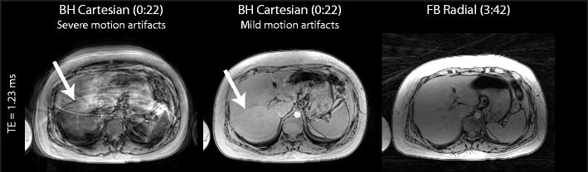
Radial
Example: Free-breathing imaging
Image source: Armstrong, T., Ly, K.V., Murthy, S. et al. Free-breathing quantification of hepatic fat in healthy children and children with nonalcoholic fatty liver disease using a multi-echo 3-D stack-of-radial MRI technique. Pediatr Radiol 48, 941–953 (2018). https://doi.org/10.1007/s00247-018-4127-7

Slide 34
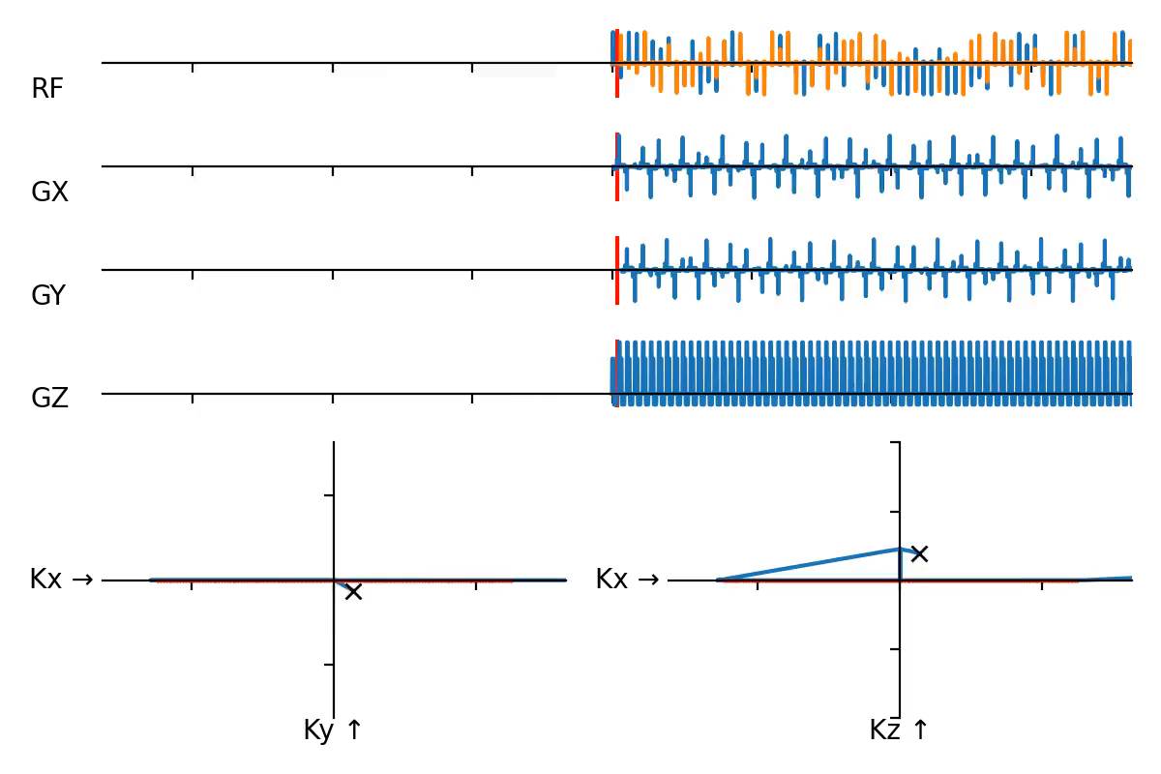
Golden angle radial
Golden-angle increments in spoke angle
More or less uniform sampling of k-space over any sub-segment of scan
Often used for dynamic/real-time imaging

Slide 35
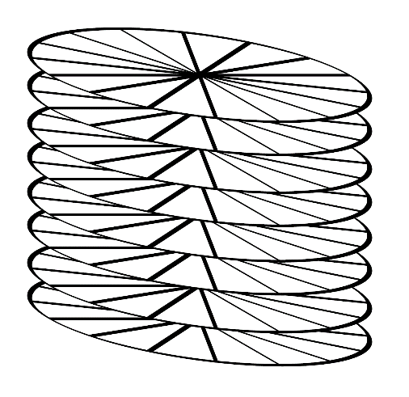
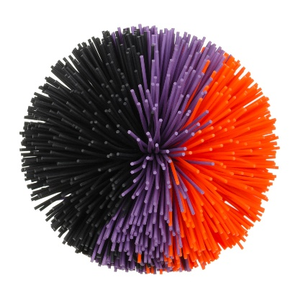
3D Radial
Stack of stars
In-plane radial combined with Cartesian phase-encoding in slice direction
Kooshball
Radial encoding in all 3 dimensions

Slide 36
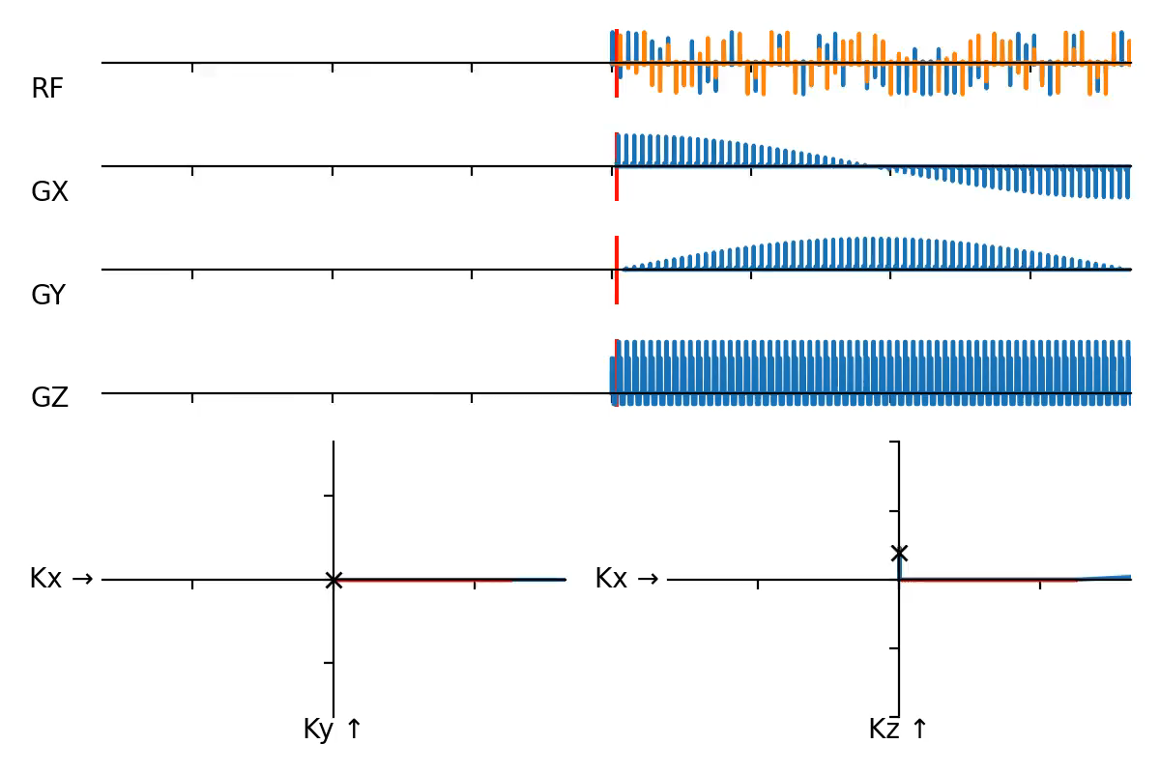
Center-out radial
Immediately start acquisition from the center of k-space
Ultra-short echotime (UTE)
In the order of ~10+ µs
Sample during the ramp-up of the readout gradient
Often non-selective 3D kooshball to avoid time spent in phase encoding and slice selection
Implementation:
seq.add_block(gx_pre, gy_pre)
seq.add_block(*pp.rotate(gx, angle=phi, axis=‘z’), adc)

Slide 37
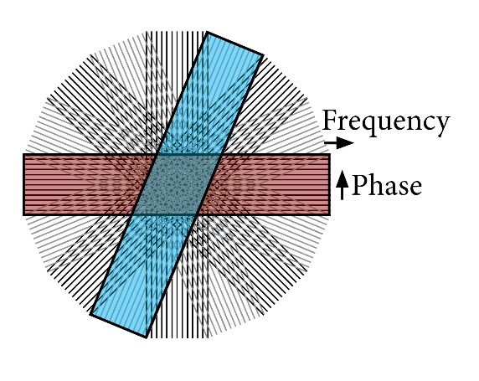
Radial: PROPELLOR/BLADE
Rotate a 2D Cartesian sampling pattern in a radial pattern
Each blade encodes small Cartesian k-space
Each blade can be reconstructed individually
Low resolution perpendicular to radial direction
Enables retrospective motion correction

Slide 38
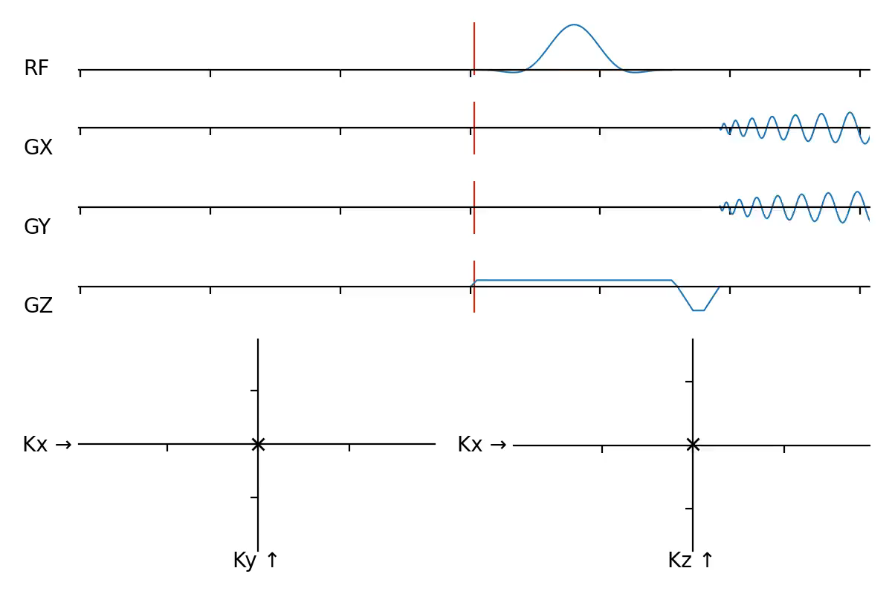
Spiral
Trajectory start in k-space center and spirals outward
Sinusoidal gradient waveforms
Single-shot
Encode whole k-space in one repetition
Real-time dynamic imaging
Not suitable for 3D
Multi-shot
Same gradient waveforms, but each repetition uses a different rotation (similar to radial)
3D: e.g. spiral cones

Slide 39
Spiral
Advantages
Very efficient
High speed of k-space traversal
Almost no dead-time
Low TE
Robust to motion
SNR efficiency
Incoherent aliasing artifacts
Also appropriate for CS reconstruction and MR fingerprinting
Low T2* decay in center of k-space
Uniform sampling everywhere but the center
Disadvantages
Susceptible to off-resonance artifacts (e.g. susceptibility, fat, bad shimming)
Reconstruction

Slide 40


Spiral: Artifacts
Flow artifacts
Susceptibility artifacts
Image source: M. Ooi et al, Benefits and Challenges of Spiral MRI in Routine Clinical Brain Imaging: Early Results, in Proceedings of the 26th Annual Meeting of the ISMRM, nr. 0349, 2018

Slide 41
Spiral: Implementation notes
Rapid switching of gradients
Easy to hit PNS limits
If you have access to SAFE PNS model parameters:
seq.calculate_pns(…)
Acoustic resonances: check “forbidden frequencies” of your scanner
`traj_to_grad` function converts trajectory specification to gradient waveforms
Does not check maximum gradient amplitude, slew rate and PNS limits
Using a long ADC event
Siemens-specific:
seq.set_definition('MaxAdcSegmentLength', samples_per_segment)
Tells interpreter to split long ADC into segments of specified length
Each segment start/end needs to be aligned to gradient raster time
Maximum of 128 segments

Slide 42

Final remarks
Which trajectory works for you depends on the application
Nothing comes for free
Do not be afraid to experiment and combine different elements of different trajectories
My latest project:
Multiple echo DESS (-> MESS) contrasts
2x 16 echoes
3D radial BLADE pattern
Organized on a kooshball
Profile ordering within 3D Cartesian BLADE
EPI readout

Slide 43
Questions?

